Slide 1
軟體工程設計 W9
許庭瑋、陳君翰、洪世彬、劉玠均、楊昕叡、林俊佑
2023/11/16

Slide 2
Code Tracing

Slide 3
Weekly Code Tracing Progress
 | Part | LOC
spring-core-core
許庭瑋 | Netty5DataBuffer.java, NettyDataBufferFactory.java , Netty5DataBufferFactory.java, DefaultDataBufferFactory.java | 504
楊昕叡 | MergedAnnotationCollectors.java, MergedAnnotationPredicates.java, MergedAnnotationSelector.java, MergedAnnotationSelectors.java, RepeatableContainers.java | 335
劉玠均 | ResolvableType.java (1/2), SerializableTypeWrapper.java | 627
洪世彬 | org.springframework.core.task | 514
spring-core-aot, spring-core-cglib
陳君翰 | org.springframework.aot.nativex.* | 646
林俊佑 | cglib.core.ClassEmitter + ClassInfo + Signature | 600

Slide 4
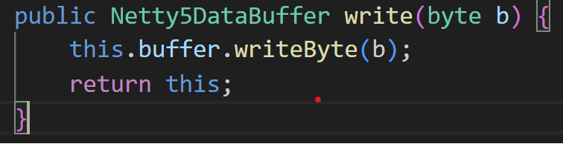
許庭瑋
DataBuffer
what I learned last week, provide a convenient wrapper around ByteBuffer
Netty5DataBuffer
Implementation of the DataBuffer with Netty 5 Buffer
like NettyDataBuffer, most of the functions just call function of Buffer, like picture above
indexOf(IntPredicate predicate, int fromIndex): using Buffer.openCursor to iterate datas in buffer and test data with predicate
write(DataBuffer... dataBuffers): check if there is at least one NettyDataBuffer in the array. if true, change type of all elements in dataBuffers to NettyDataBuffer, and use Buffer.writeBytes to write datas
Notes:
IntPredicate: like lambda
IntPredicate isOdd = argument -> argument % 2 == 1
The ByteCursor scans through a sequence of bytes.
netty: 1個java 的框架，用於非阻塞I/O客戶端-伺服器
netty 5:現在穩定版是4.1.100，netty5 是beta版

Slide 5
許庭瑋
Netty5DataBuffer
BufferComponentIterator: an iterator for Buffer, mostly delegate to ComponentIterator。
DataBufferFactory
A factory for DataBuffer, allowing for allocation and wrapping of data buffers.
DefaultDataBufferFactory
Default implementation of DataBufferFactory
boolean preferDirect; check if buffer is direct
can allocating buffer by calling allocate or allocateDirect
can wrap ByteBuffer into buffer of DefaultDataBuffer class
Notes:
工廠模式:藉由定義一個class來負責建立其他class的instance
direct: wrap: join:
ComponentIterator: netty 5裡面的一個iterator
有很多建buffer的方法，所以要factory
The main purpose of the DataBuffer abstraction is to provide a convenient wrapper around ByteBuffer which is similar to Netty's ByteBuf but can also be used on non-Netty platforms

Slide 6
許庭瑋
DefaultDataBufferFactory
join(List<? extends DataBuffer> dataBuffers): use DataBuffer.readableByteCount to calculate how many data to write, the use write() for each databuffer into resultBuffer, and release all databuffer.
NettyDataBufferFactory
implementation of DataBufferFactory with ByteBufAllocator
can allocateBuffer, wrap, and join
join(List<? extends DataBuffer> dataBuffers): use compositeBuffer to create a CompositeByteBuf buffer, and use CompositeByteBuf.addComponent to put data into buffer
Notes:
? extends: 所有DataBuffer的子類
ByteBufAllocator: allocate a buffer to ByteBuf
CompositeByteBuf: netty 可以把很多buffer合併成一個buffer的type

Slide 7
許庭瑋
Netty5DataBufferFactory
implementation of DataBufferFactory with BufferAllocator
very same as NettyDataBufferFactory, the only difference is in netty 4, it use ByteBufAllocator. In netty 5, it use BufferAllocator. The implementation of functions are same as NettyDataBufferFactory, except that the buffer name and the functions name of buffer are different.
Notes:
BufferAllocator: allocate a buffer to Buffer
Bytebuf跟Buffer區別: 官網都沒說

Slide 8
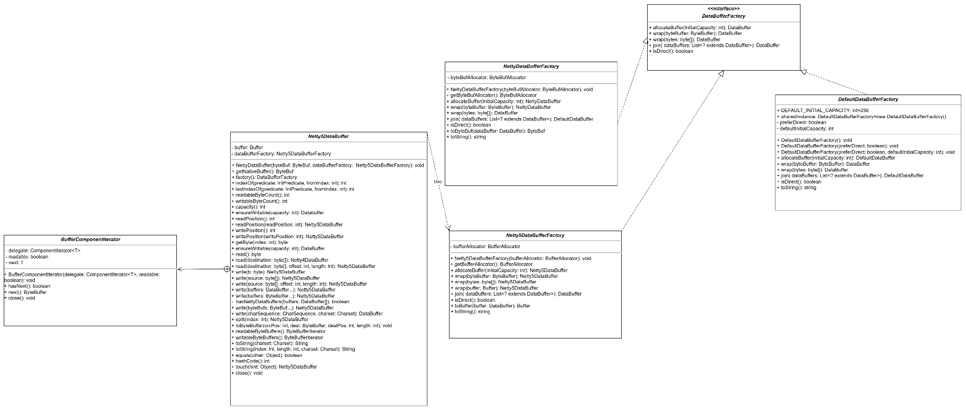
許庭瑋
UML this week
full version

Slide 9
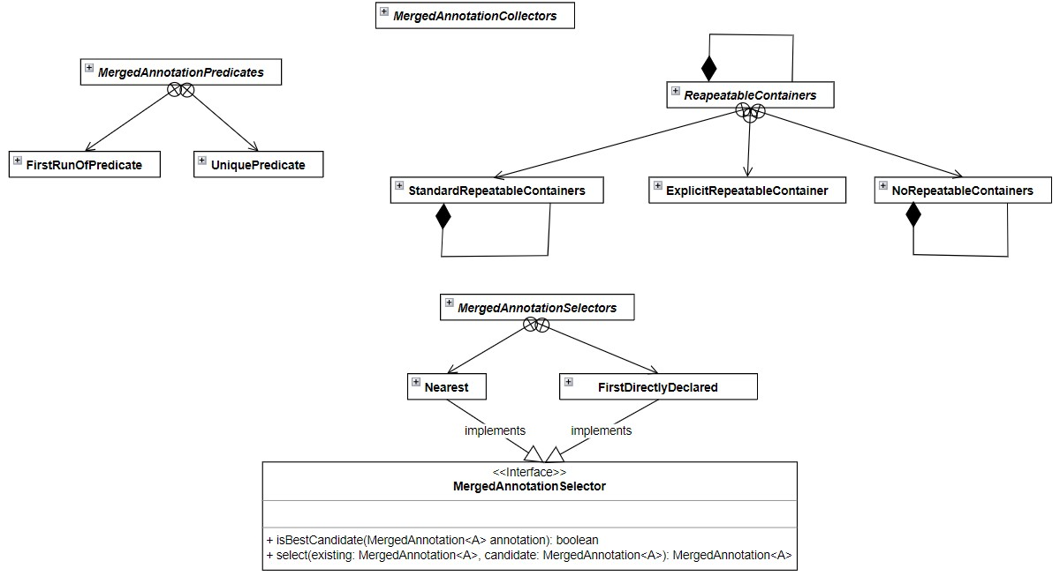
楊昕叡
class diagram:
full version
Notes:
ConvertingComparator<S, T>, DefaultConversionService, 8 default converters

Slide 10
楊昕叡
public abstract class RepeatableContainers has 3 inner classes
private static class StandardRepeatableContainers extends RepeatableContainers
findRepeatedAnnotations(): find an attribute method from given attotation’s type and invoke it on given annotation
delegate finding attribute method and invoking to AttributeMethods.forAnnotationType() and AnnotationUtils.invokeAnnotationMethod()
attribute method: method having no argument but with non-void return type

Slide 11
楊昕叡
private static class ExplicitRepeatableContainer extends RepeatableContainers
findRepeatedAnnotations(): find an attribute method from given container and invoke it on given annotation
delegate finding attribute method and invoke to AttributeMethods.forAnnotationType() and AnnotationUtils.invokeAnnotationMethod()

Slide 12
楊昕叡
private static class NoRepeatableContainers extends RepeatableContainers
Null Object Pattern

Slide 13
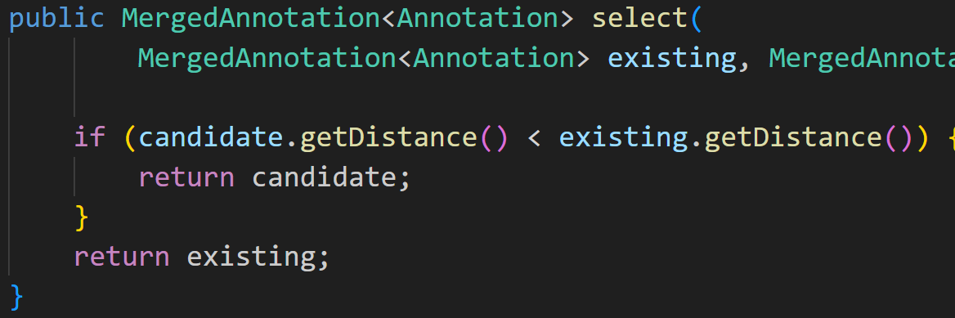
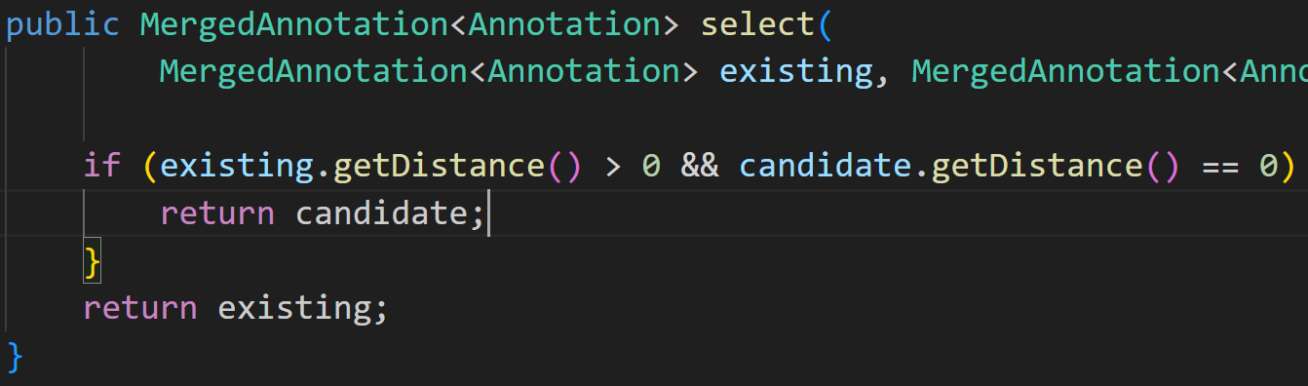
楊昕叡
public abstract class MergedAnnotationSelectors
select between two annotation
private static class Nearest implements MergedAnnotationSelector<Annotation>
select the annotation with smaller distance
private static class FirstDirectlyDeclared implements MergedAnnotationSelector<Annotation>
select the first directly declared annotation

Slide 14
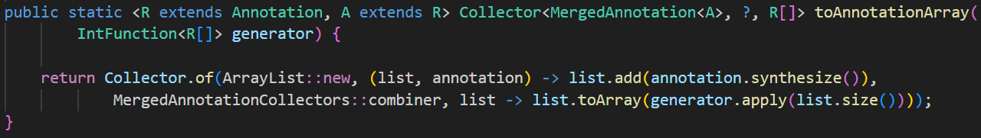
楊昕叡
public abstract class MergedAnnotationCollectors
package annotations into set, array, map

Slide 15
楊昕叡
public abstract class MergedAnnotationPredicates
Function<? super MergedAnnotation<A>, ?> valueExtractor
private static class FirstRunOfPredicate<A extends Annotation> implements Predicate<MergedAnnotation<A>>
match only the first run value
{1, 1, 2, 1} -> first two 1 are true
private static class UniquePredicate<A extends Annotation, K> implements Predicate<MergedAnnotation<A>>
match only if the value has not seen before
{1, 2, 3, 1} -> first three values are true

Slide 16
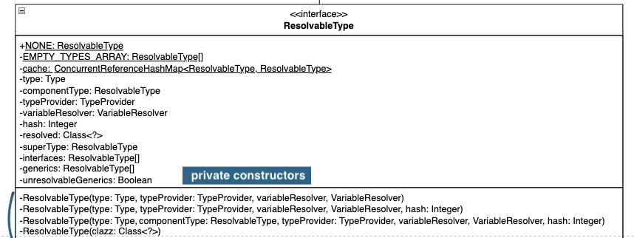
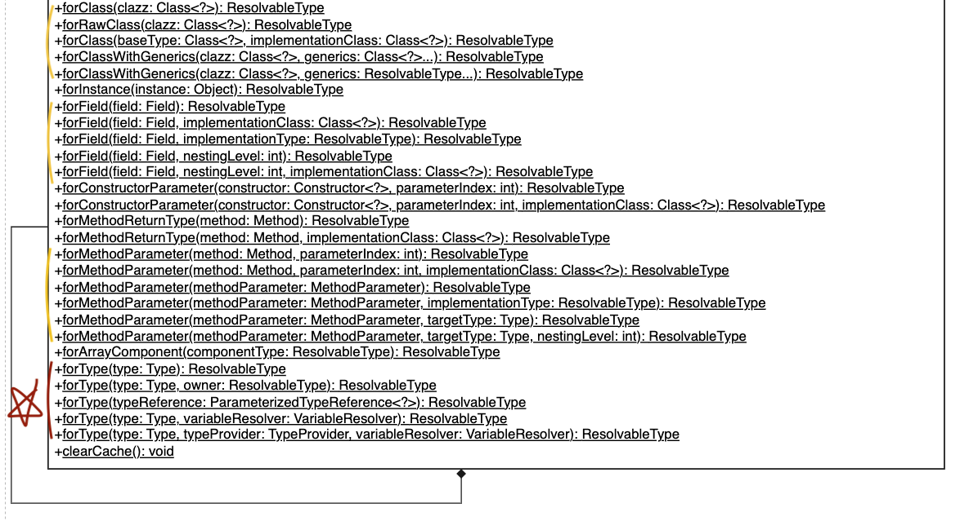
劉玠均 (ResolvableType)
Class diagram full version
Code reading breakdown
W8: get/resolve functions
W9 (this week): for* (e.g., forType()) functions
for* functions
forClass, forField, forMethodParameter …
forType

Slide 17
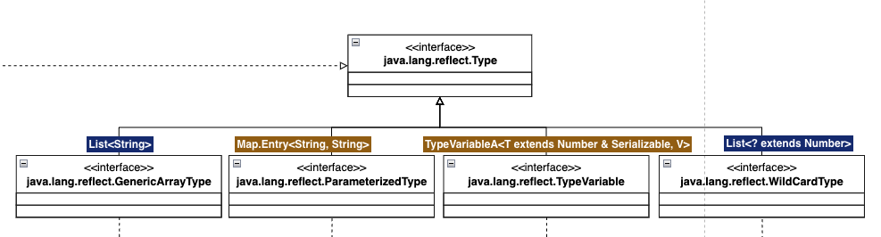
劉玠均 (ResolvableType)
Typical Usage of Private Constructor (ref)
The Singleton Pattern: the class can only be instantiated once
Delegating constructors: restrict class initialization to specific constructor
Uninstantiable classes: the class cannot be initialized such as StringUtils
The Builder Pattern: use builder to assemble parameters to avoid creating various type of constructors
For ResolvableType, it supports four types as follow:
Notes:
resolveVariable

Slide 18
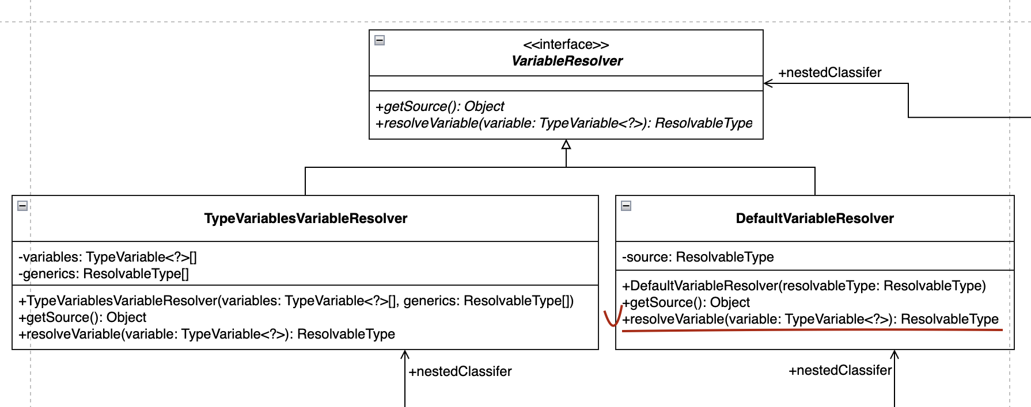
劉玠均 (ResolvableType)
Use forType(type: Type, typeProvider: TypeProvider, variableResolver: VariableResolver) to initialize the private constructor

Slide 19
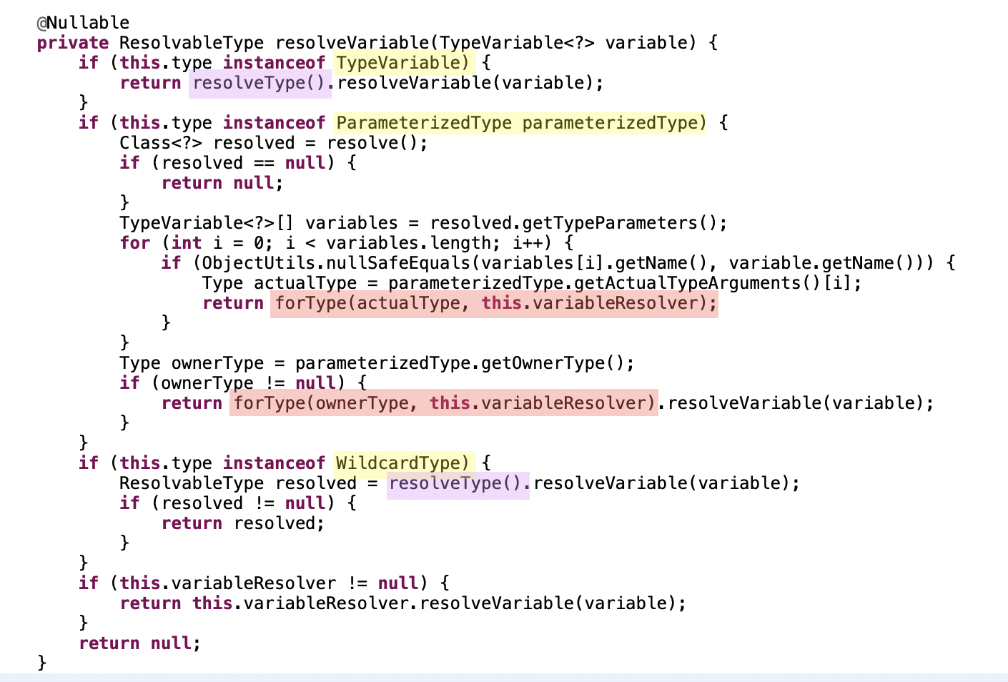
劉玠均 (ResolvableType)
resolveVariable(): Pass in different parameters to the correspond forType(...) function.
For WildcardType and TypeVariable, deal with resolveType().
Notes:
List<? super String>, the upper bound is java.lang.Object, the lower bound is java.lang.String
TypeVariableA<T extends Number & Serializable, V>
T key -> getBounds: class java.lang.Number, interface java.io.Serializable,
-> getGenericDeclaration: class …TypeVariableA
-> getName: T
V value -> getBounds: java.lang.Object, others same as K

Slide 20
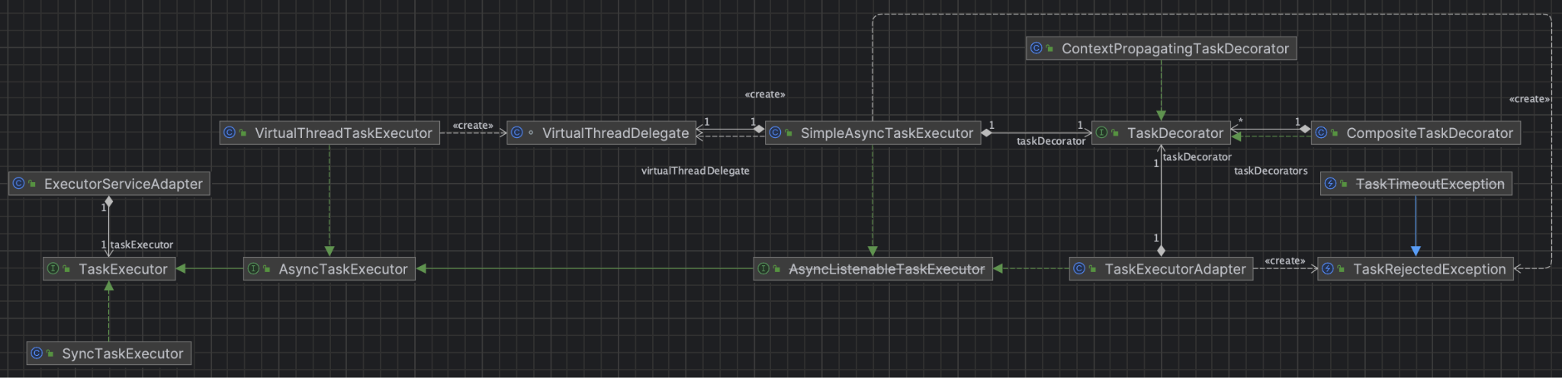
洪世彬
The following diagram is the UML for the Task package, which primarily handles the execution of Runnable objects. Detailed introductions to some classes will be provided on the following pages.

Slide 21
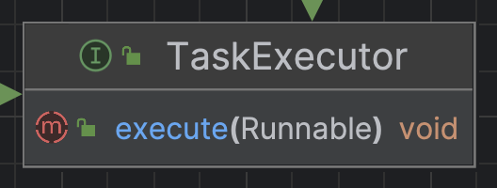
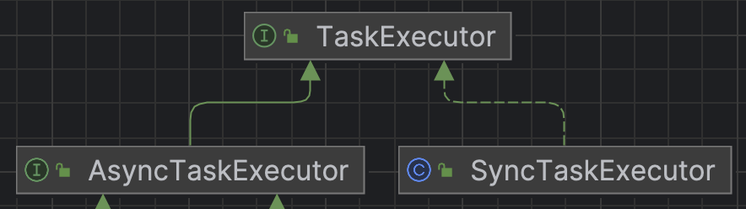
洪世彬
The "TaskExecutor" defines an interface that provides an "execute" method to execute objects of the "Runnable" type. Its subclasses implement two types: Sync and Async.

Slide 22
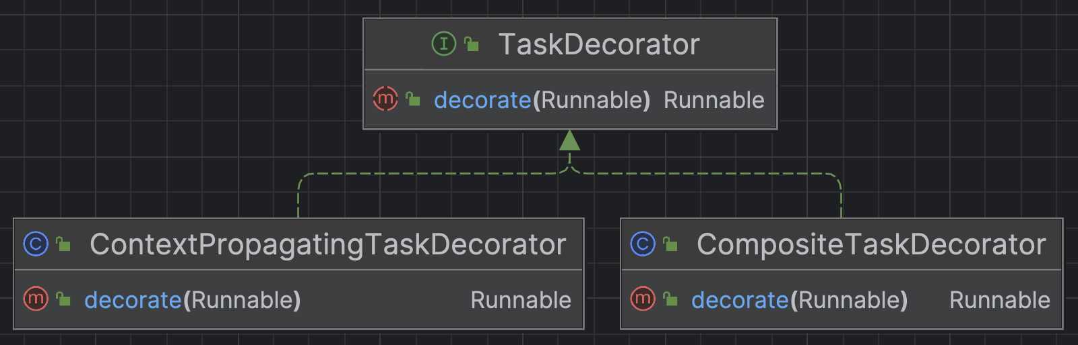
洪世彬
"TaskDecorator" applies the concept of the Decorator Pattern, allowing subclasses to implement different decorating methods. However, unlike the common Decorator Pattern, TaskDecorator wraps through the provision of a method, which is a unique implementation.

Slide 23
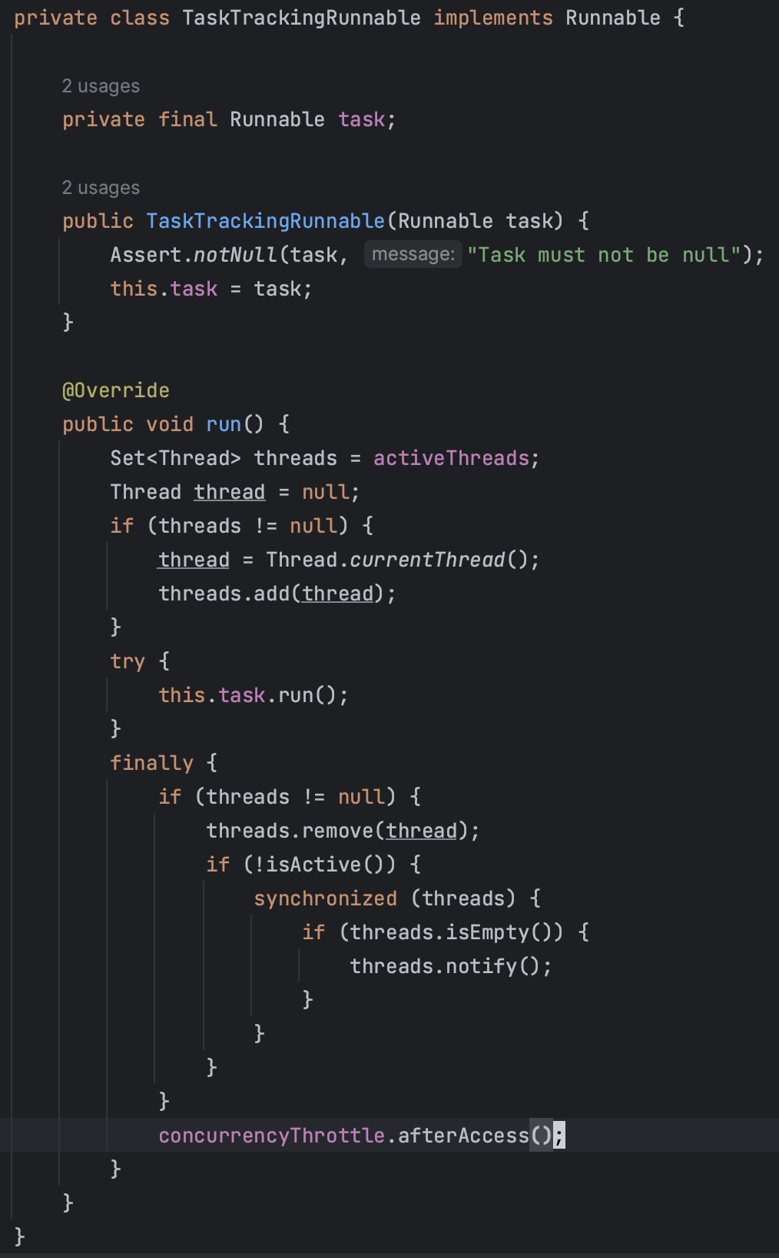
洪世彬
In comparison, the Inner Class of "TaskTrackingRunnable" uses a more standard Decorator Pattern.

Slide 24
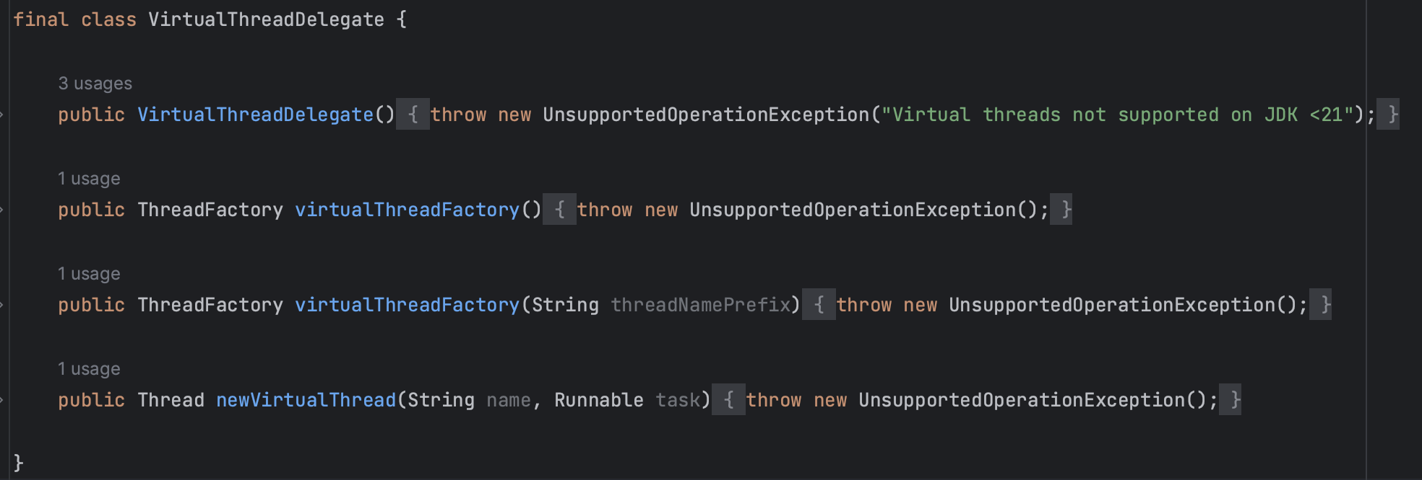
洪世彬
The concept of "VirtualThreadDelegate" is like an empty object and throws UnsupportedOperationException in JDK versions prior to 21.

Slide 25
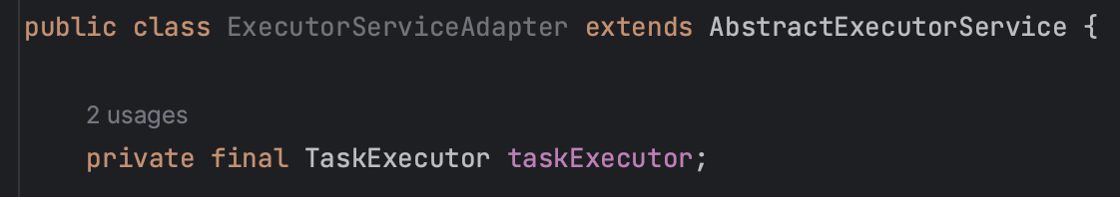
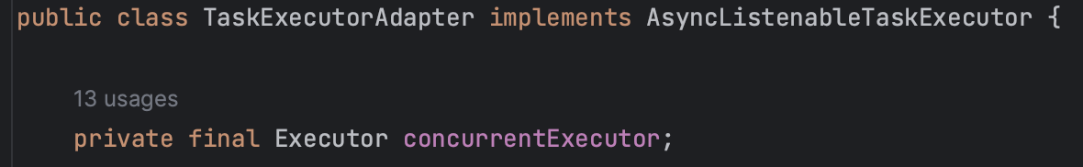
洪世彬
"ExecutorServiceAdapter" and "TaskExecutorAdapter" use the Adapter Pattern. "ExecutorServiceAdapter" provides an adaptation from "AbstractExecutorService" to "TaskExecutor," while "TaskExecutorAdapter" adapts from "TaskExecutor" to "Executor."

Slide 26
陳君翰
主要的內容區段：org.springframework.aot.nativex
功能介紹：把 runtime hint 轉為 GraalVM native configuration 的格式
拿 runtime hint 進來，runtime hint 中有 serialization, proxies, reflection, resource, jni，只要這些東西存在，就叫各自的負責的 writer 進來（eg. `ResourceHintsWriter`），寫成一個 xxx-config.json file
這裡會一直用到 BasicJsonWriter，他的功能就只是把 object 轉為 json 格式，它會一直以 Consumer, Runnable 的輸入被依賴注入到各個需要的地方

Slide 27
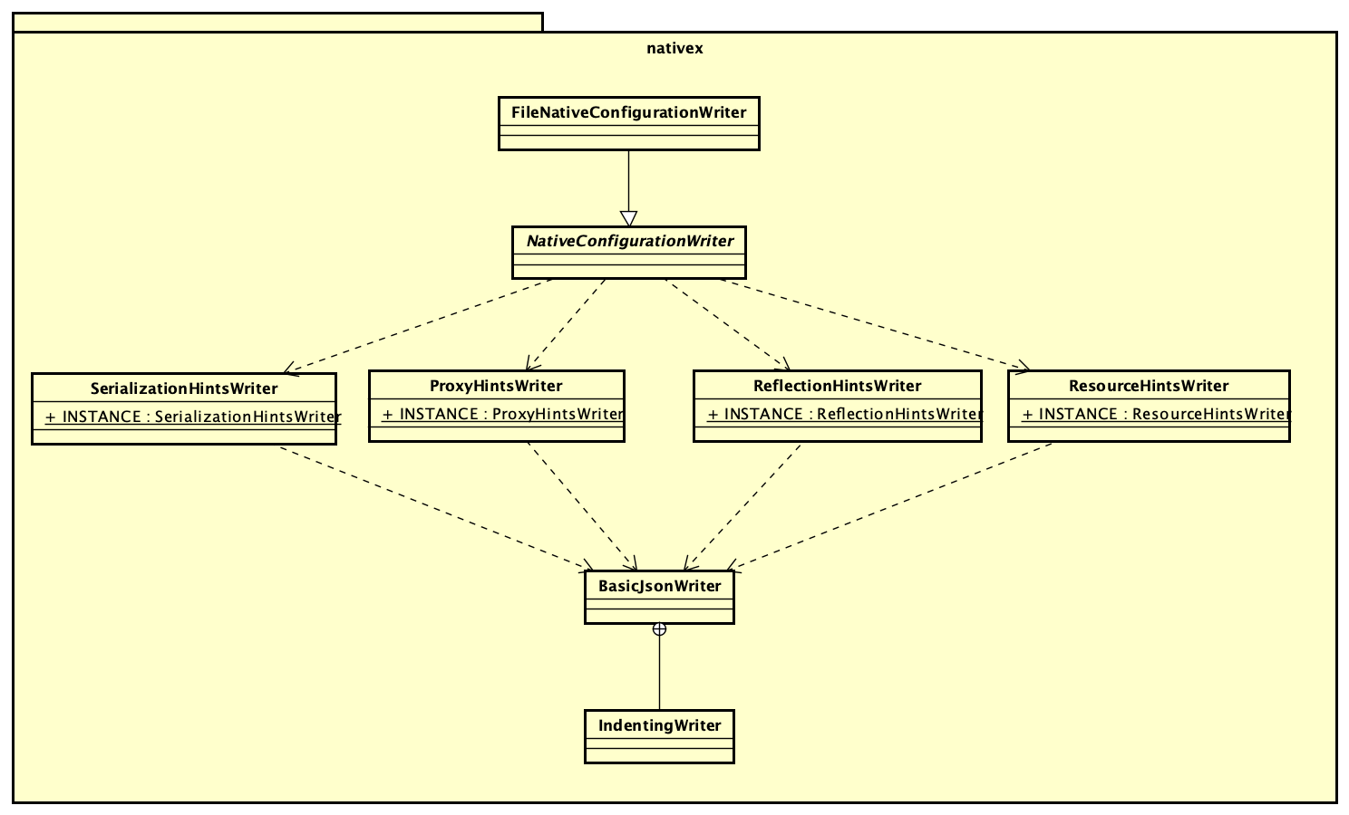
陳君翰

Slide 28
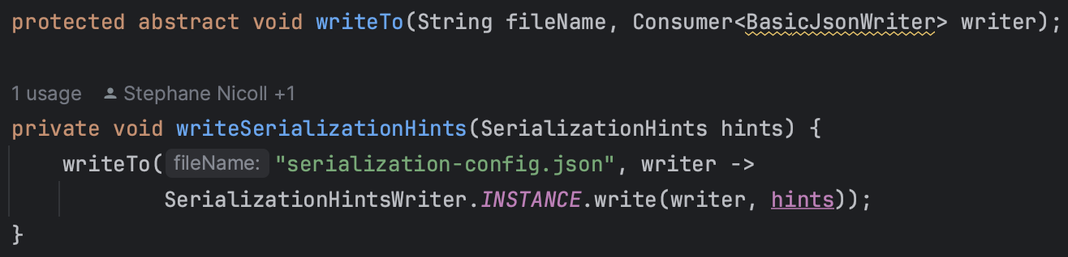
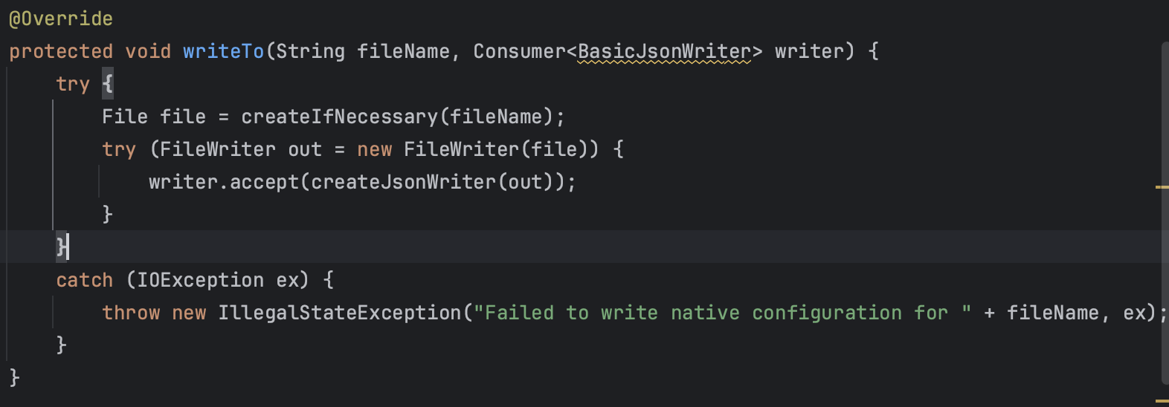
陳君翰
上圖：NativeConfigurationWriter
下圖：FileNativeConfigurationWriter
put BasicJsonWriter into Consumer，inject it into SerializationHintsWriter

Slide 29
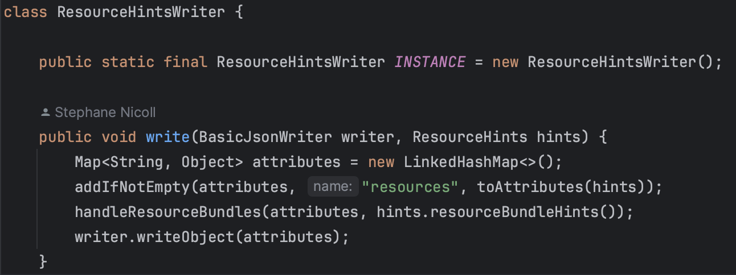
陳君翰
The 4 hint writers all uses
Singleton Pattern
no public constructor
can directly use the only INSTANCE
Dependency Injection to get BasicJsonWriter

Slide 30
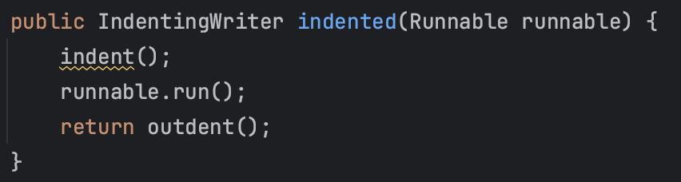
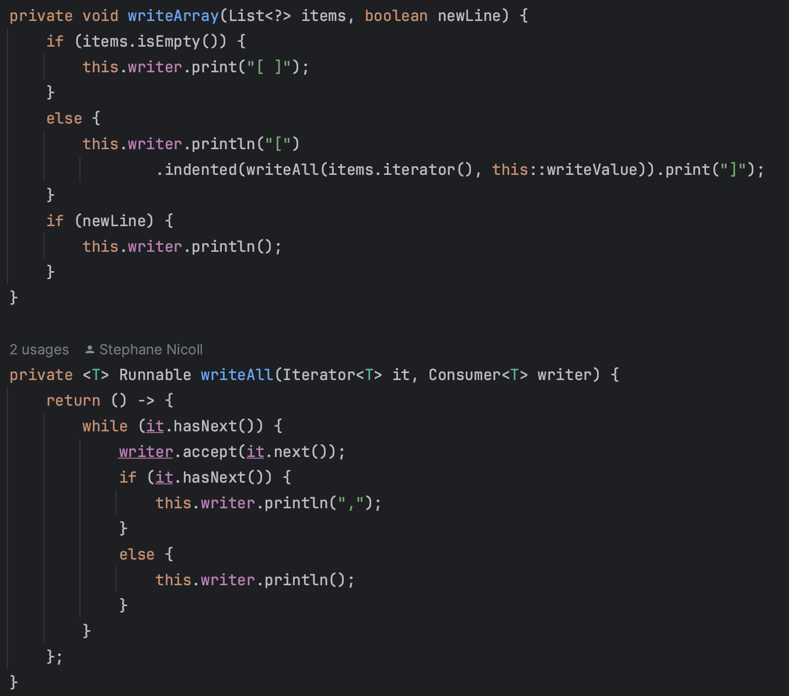
陳君翰
BasicJsonWriter, IndentingWriter
使用 Runnable 來創造遞迴，使得縮排變得可能

Slide 31
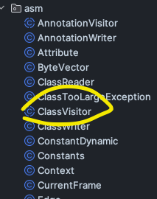
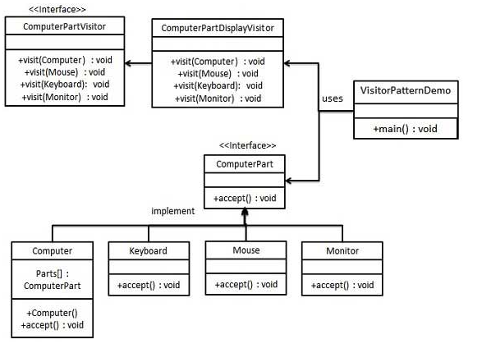
林俊佑
繼續細看 Emitter 本體, 目標是追到 asm API 的調用
為了簡化難度, 我要先閱讀一下 asm 的文件, 這樣在 CGLIB 中看到他們時才比較有感覺
首先透過檔案命名可以猜測 asm 屬於 “訪問者” 模式

Slide 32
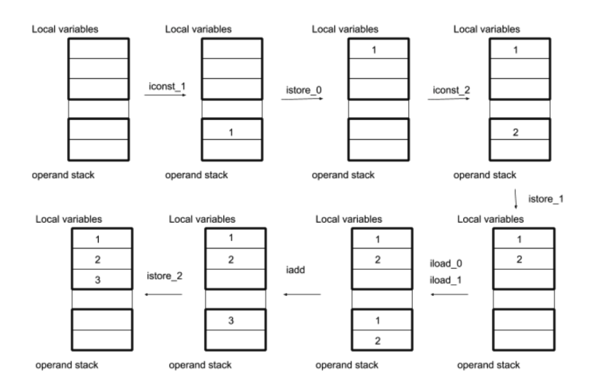
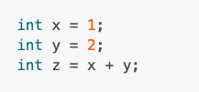
對訪問者模式
我個人認為重點在每個物件加入 accept 方法, 透過依賴注入visitor物件, 再把個物件本身this 放入visitor 交給它執行外部邏輯
好處是可以輕易添加針對不同物件的業務邏輯在獨立的訪問者, 查看調用範例, 發現 asm 訪問者可以針對 class 執行符合 JVM 標準操作的代碼

Slide 33
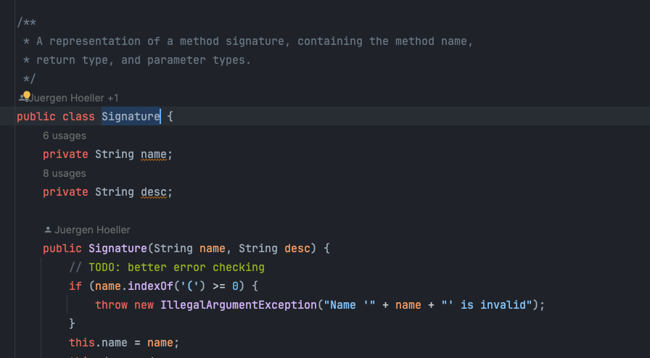
開始查看 classEmitter 結構
ClassInfo => 輸入 class type => 取得 class 資訊
MethodVisitor => asm 中的實作
Signature => 方法名稱的 string 的包裝

Slide 34
最後要看的是 CodeEmitter 發現其繼承自 LocalVariablesSorter
而 LocalVariablesSorter 繼承自 asm 中的 MethodVisitor
這週先細看 LocalVariablesSorter 下週在看 CodeEmitter
推測 CodeEmitter 會是 CGLIB 基於 asm API 最終要的包裝

Slide 35
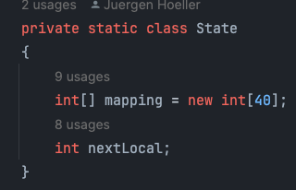
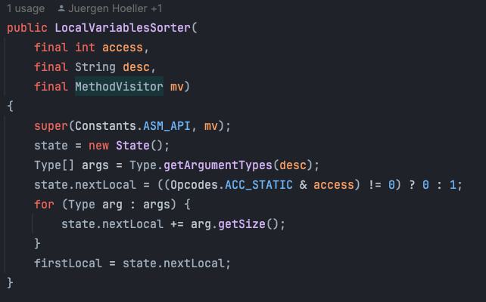
創建 local 狀態紀錄
每個局部變量有其各自型別與對應大小, 依照大小存在 array 裡, 使之後可以依照 array 快速取到變量

Slide 36
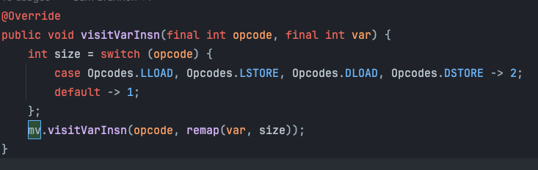
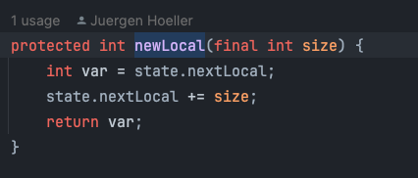
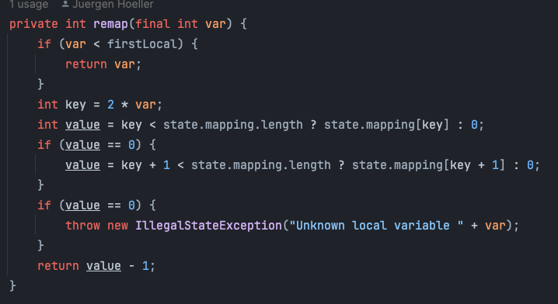
在 JVM 的 Stack 中執行 load/store 操作
在尾部新增變數
輸入第幾個變數, 取得在狀態 map （constructor 中建立）的位置

